Slide 1

BANKING

Slide 2


What is a bank?
A place where:
You can keep your money safe
Your money can grow

Slide 3

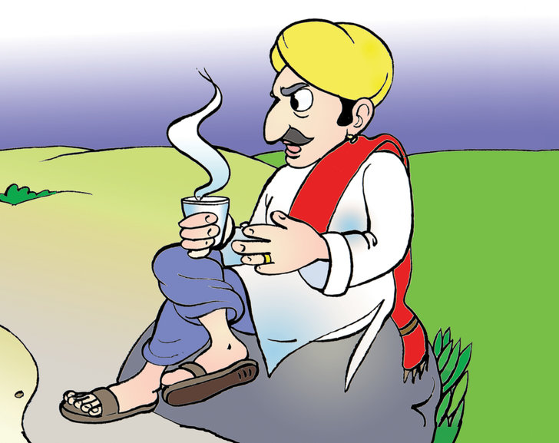
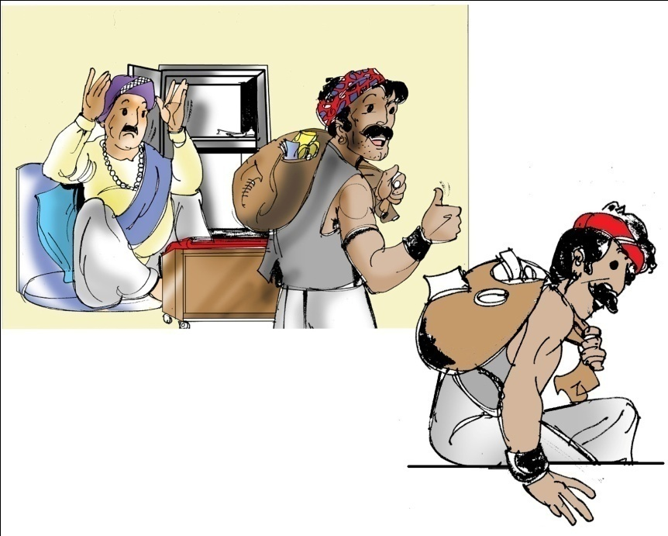

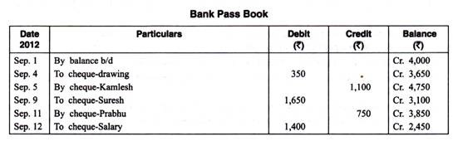
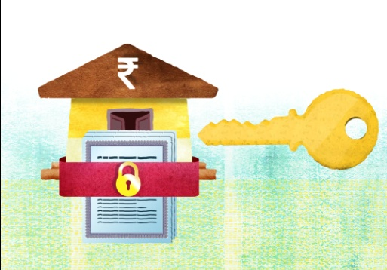

Why do we need banks?
To keep the money we earn safe
To get into the habit of saving
To grow our money through interest
To account for all incoming and outgoing money
To avoid risk of chit funds and Sahukars
To avail of loans

Slide 4
What are the types of bank accounts?
Savings
Current
For Individuals to deposit savings and use when required
For Businesses to handle large number of transactions

Slide 5

What do I need to open a bank account?
Proof of Identity
You are who you say you are
Proof of Address
You live where you say you live
Signature
Any document that covers the above needs to be submitted to the bank to get your bank account!

Slide 6
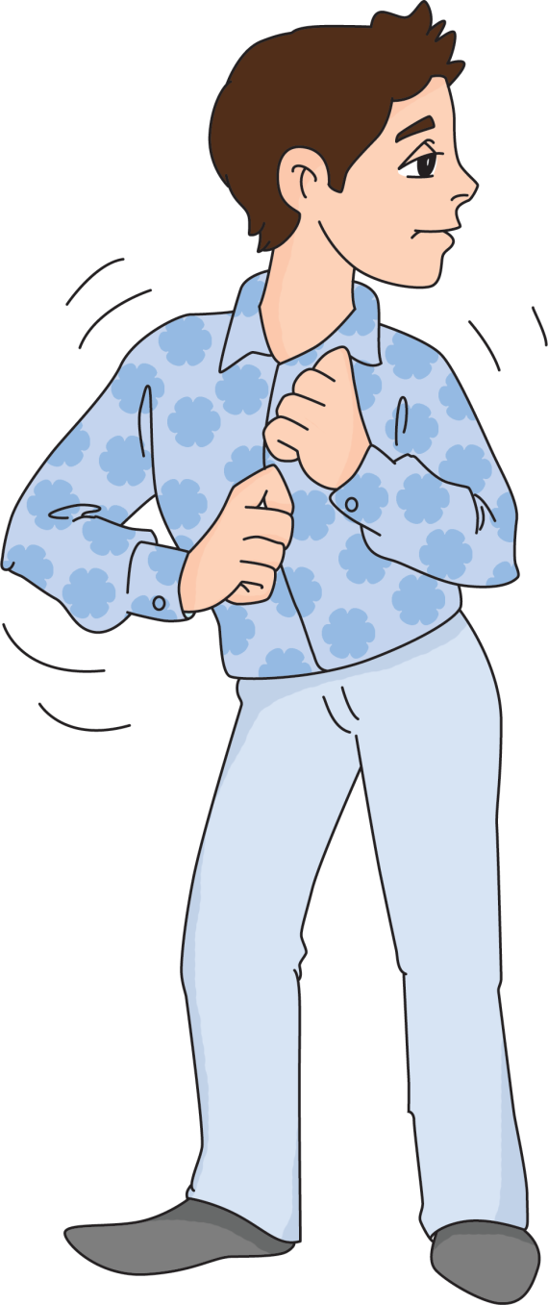
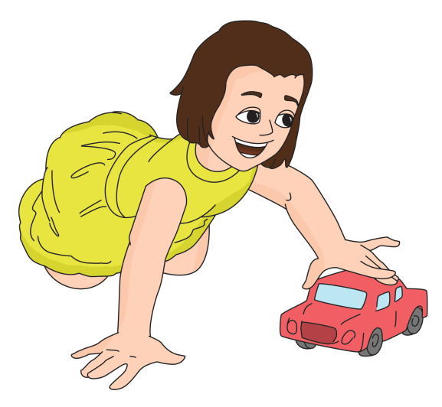

Age Limit for Bank Account
I want to open a bank account in my 3 year old daughter’s name. Is that allowed?
There is no upper age limit for opening a bank account. It can be opened once a person has a birth certificate and used for their lifetime
You can create a MINOR account. You only need her Birth Certificate

Slide 7
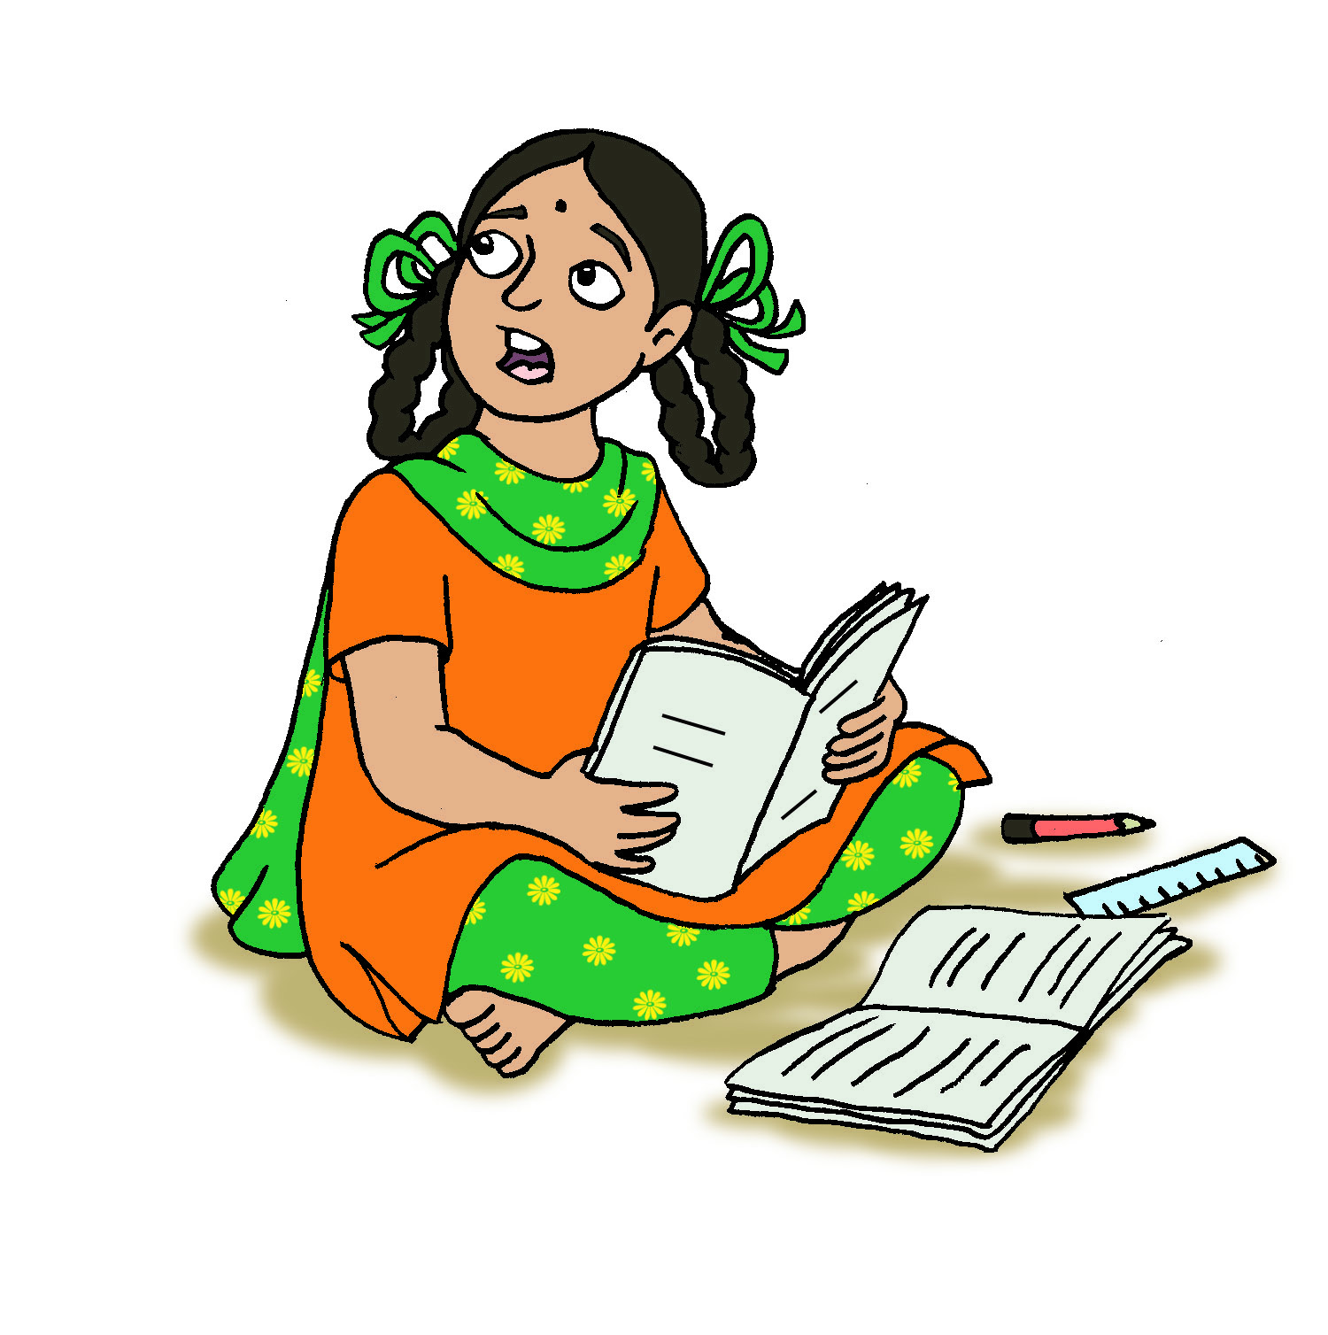
What are joint bank accounts?
I am earning in Mumbai now and I want to give my younger sister money for college. How can I do that?
A Joint Bank Account has more than 1 person as Account Holder
All account holders can use the money in the account freely
If one of the account holders dies, the account gets transferred in the name of the others
Open a JOINT bank account

Slide 8
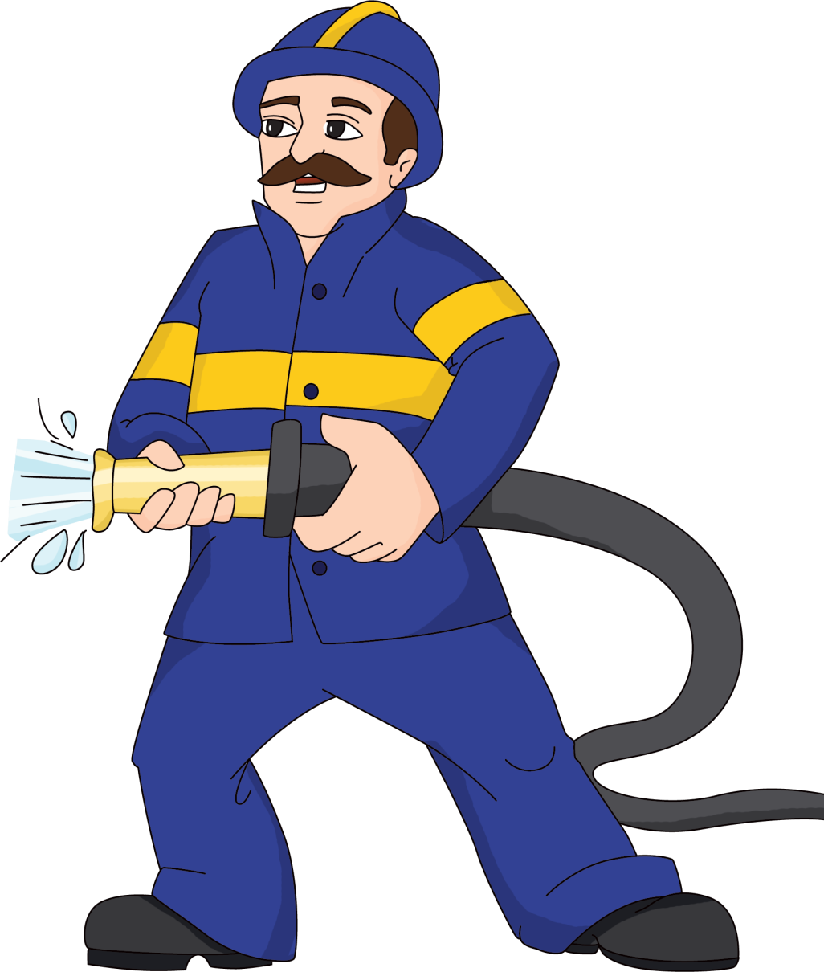
What is a bank account nominee?
I have such a dangerous job. What will happen to the money in my account if something happens to me?
A nominee can be added at any time by filling a nomination form
The nominee’s signature is not required
There can be only one nominee per account
Add a nominee to your account. If you die, the money will go to the nominee

Slide 9
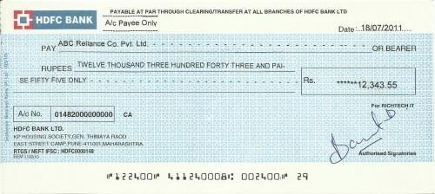
What is a Cheque?
A cheque is a printed form that orders the bank to pay money from your account into another account
Bank Name
Payee Account
Cheque Date
Amount
IFSC Code
Branch Address
Signature
MICR Code
Account Number
Cheque Number

Slide 10
What’s next?
This video covered basic banking.
Refer to more banking videos:
Banking - ATMs
Internet Banking/Mobile Banking
Banking - Deposits

